Slide 1

A Time-Domain Spread Spectrum Approach for Low-Latency Audio Watermarking
Paper ID: 340
Presenter name: Shiva Kumar, Naga Phanindra Bandreddy

Slide 2
Outline
Introduction
Literature Survey
Methodology
Result and Discussion
Conclusion
References

Slide 3
Introduction
Rapid growth of multimedia and real-time audio applications such as streaming, video calls, and live broadcasting.
Increasing concerns regarding copyright protection, security, and content authentication.
Audio watermarking enables invisible embedding of ownership and authentication information into audio signals.
Watermarking systems must balance key factors: imperceptibility, robustness, and capacity (magic triangle)
Traditional methods (DWT, SVD, deep learning) improve robustness but suffer from high computational complexity.
Most existing systems are designed for offline processing, assuming full audio availability
Real-time applications require very low latency (≤ 25 ms) for proper interaction
There is a significant research gap in developing low-latency, real-time watermarking systems

Slide 4
Introduction
Rapid growth of multimedia and real-time audio applications such as streaming, video calls, and live broadcasting.
Increasing concerns regarding copyright protection, security, and content authentication.
Audio watermarking enables invisible embedding of ownership and authentication information into audio signals.
Watermarking systems must balance key factors: imperceptibility, robustness, and capacity (magic triangle)
Traditional methods (DWT, SVD, deep learning) improve robustness but suffer from high computational complexity.
Most existing systems are designed for offline processing, assuming full audio availability
Real-time applications require very low latency (≤ 25 ms) for proper interaction
There is a significant research gap in developing low-latency, real-time watermarking systems

Slide 5
LITERATURE SURVEY
Audio watermarking research focuses on trade-off between imperceptibility, robustness, capacity, and computational cost.
Transform domain methods (DWT, SVD) provide high robustness and capacity but increase processing complexity.
Deep learning approaches improve performance but require high computational resources, limiting real-time use.
Some methods achieve strong robustness but introduce high latency due to complex operations.
Real-time approaches exist, but many depend on full audio signal availability, limiting practical usage.
High-capacity techniques (e.g., spectrum-based methods) are computationally expensive and unsuitable for low-latency systems

Slide 6
Table 1. Comparative Analysis of Recent Audio Watermarking Techniques
Reference Paper | Technique Used | Advantages | Disadvantages / Gaps for Real-Time Use
[10] | SSVS-SSVD (SVD & Spread Spectrum) | High robustness to desynchronization attacks; Fast full-process time (<1s). | High computational complexity from SVD; Designed for stereo signals; Latency not measured for live embedding.
[11] | DWT-SVD with Parallel Computing | Achieves real-time throughput for full-file processing on multi-core hardware. | Requires entire signal a priori; Not suitable for live streaming; High hardware dependency (16-core cluster).
[12] | Ensemble Detector in DWT Domain | Very high capacity (1225 bps); Robust to MP3 compression. | High computational load from ensemble and DWT; Latency not reported for real-time contexts.
[13] | Synchronization via Spectrum Distribution | Extremely high capacity (up to 8000 bps). | Very high computational cost from spectral analysis; Impractical for low-latency applications.
[14] | Multi-Subspace Echo Hiding | Good security and imperceptibility through time-frequency masking. | Computationally complex echo kernel design; Embedding time too slow for real-time.
[15] | Spikegram & Two-Dictionary Approach | Unique bio-inspired approach; Good security. | Very high complexity from sparse coding and dictionary learning.
[16] | SVD with Integer Wavelet Transform (IWT) | False-positive-free;Good imperceptibility | Authors explicitly state it is not suitable for real-time due to high complexity.
[17] | Sorted LWT Coefficient Magnitudes | Fast extraction; Synchronous blind detection. | Computationally expensive sorting and shaping during embedding.
[8] | Temporal Domain (tamper detection) | Truly low-latency and real-time capable. | Only for tamper detection; Very low capacity; Not for general-purpose watermarking.

Slide 7
Methodology
Real-time audio watermarking is challenging due to strict latency and processing requirements.
Transform domain techniques (DWT, SVD) provide robustness but introduce high processing delay.
System latency is strongly dependent on buffer size.
Reducing buffer size decreases latency but may affect audio quality and psychoacoustic performance.
Proposed system uses frame-based processing for continuous real-time operation.

Slide 8
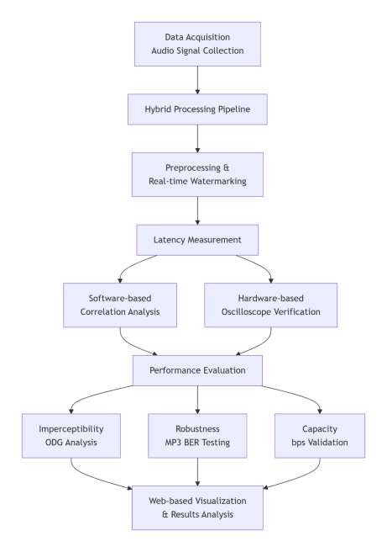
Flowchart illustrating the workflow of the proposed real-time audio watermarking system

Slide 9
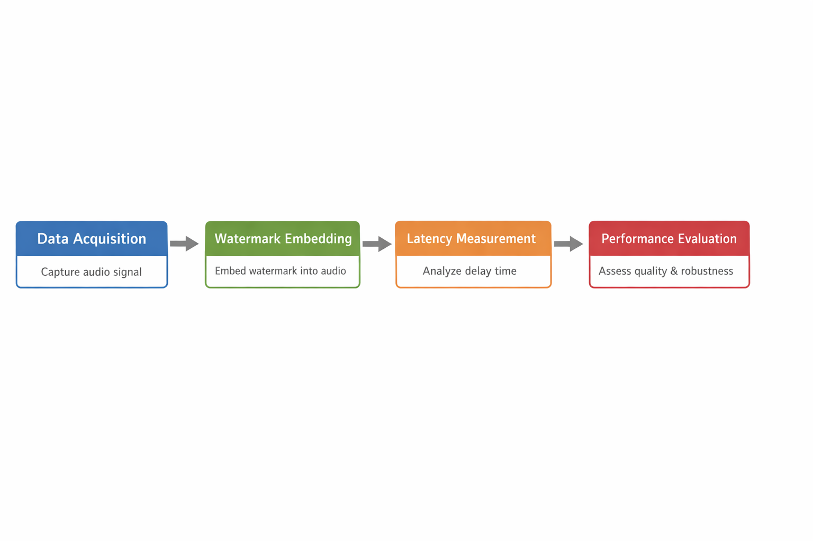
time-domain spread spectrum technique
Watermark embedding is performed using the time-domain spread spectrum
technique.
System processes audio through stages:
Implementation uses Web Audio API and browser-based processing for efficient real-time execution.

Slide 10
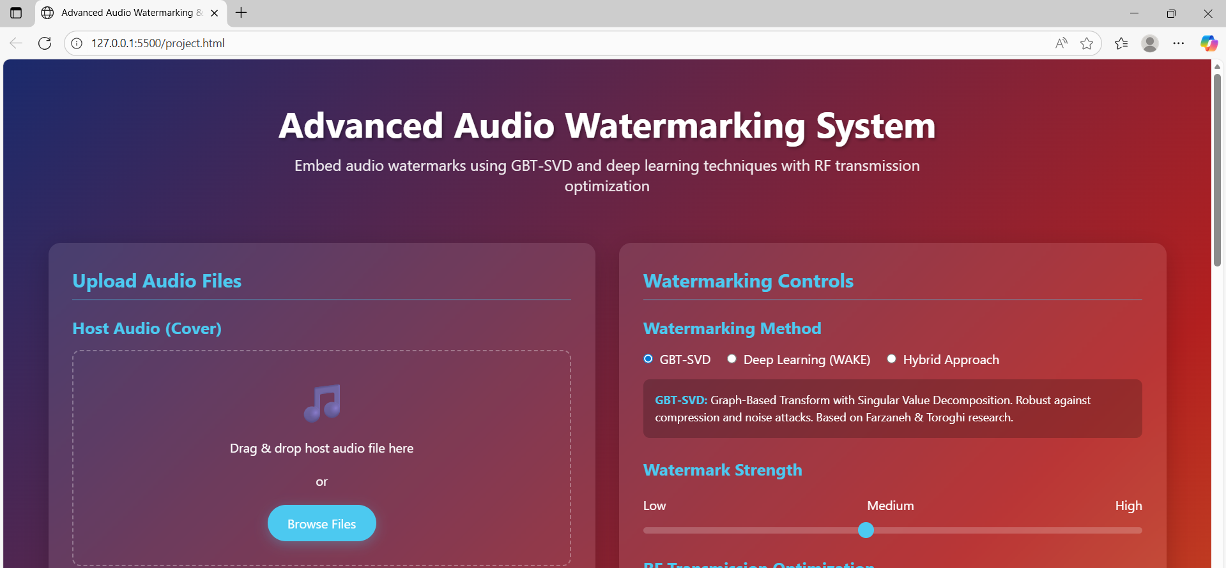
User interface of the proposed advanced audio watermarking system used for uploading audio files and configuring watermark embedding parameters

Slide 11
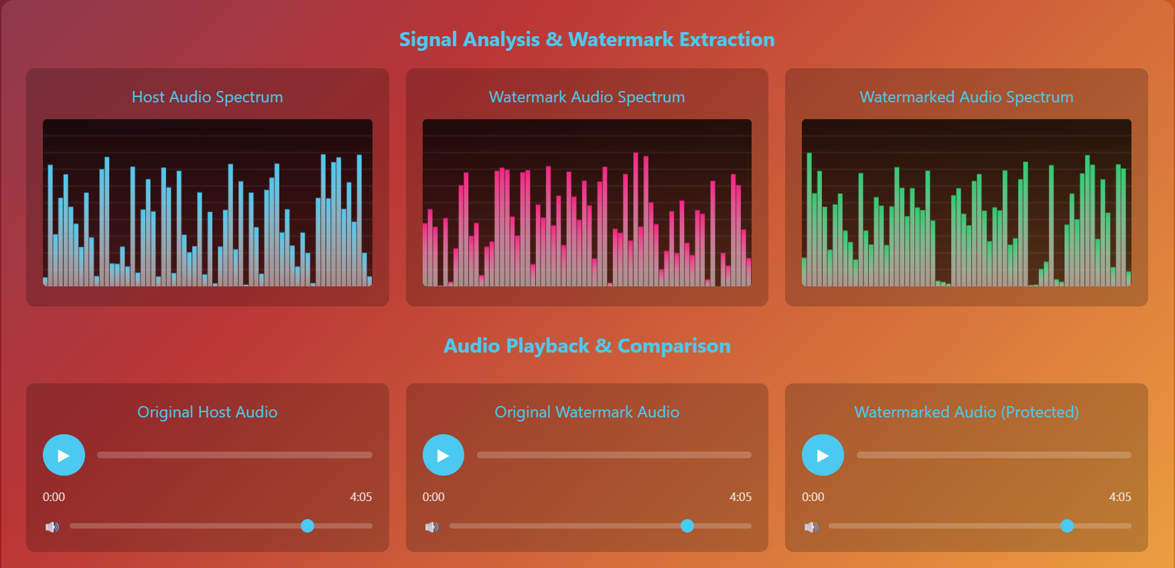
Signal analysis and watermark extraction results showing spectrum comparison between host audio, watermark audio, and the final watermarked audio signal.

Slide 12
RESULTS & DISCUSSION
System evaluated using key performance metrics: latency, imperceptibility, robustness, and capacity.
Experiments conducted on different audio types (speech and music signals).
Latency measured using: software-based method and hardware (oscilloscope) method
Results show very low embedding delay of approximately 0.53 ms.
Time-domain spread spectrum method reduces computational complexity compared to transform methods

Slide 13
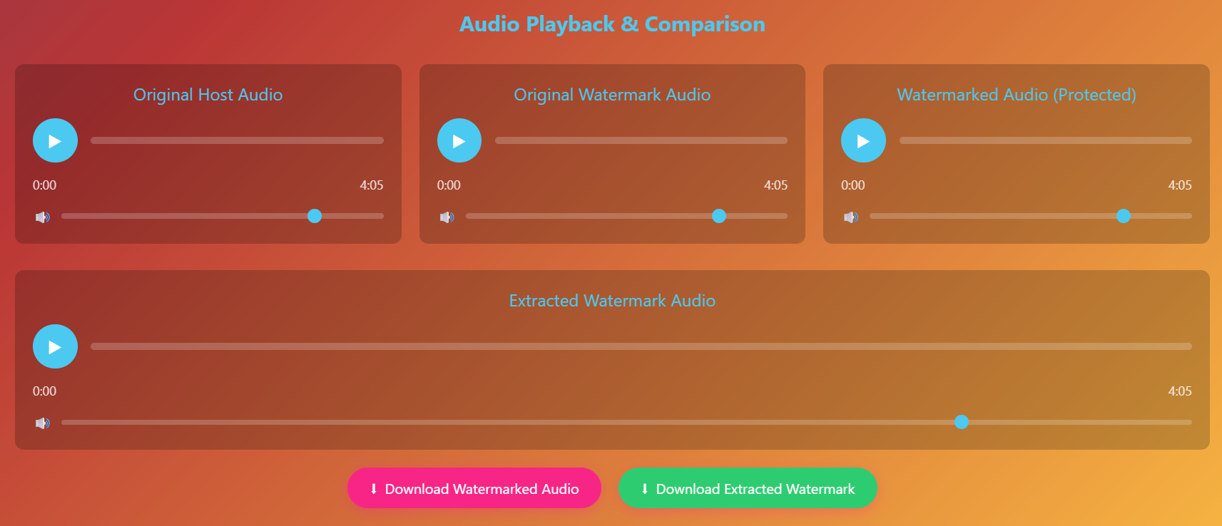
Audio playback and comparison interface showing host audio, watermarked audio, and extracted watermark signals

Slide 14
Latency Measurement Results
Method | Buffer Size (Samples | Watermarking | Latency (ms) | Standard Deviation (ms)
1(Software) | 512 | No | 30.08 | 0.00
1(Software) | 512 | Yes | 30.61 | 0.00
1(Software) | 256 | Yes | 22.63 | 0.00

Slide 15
Overall system latency reduced using small buffer size (256 samples).
Achieved 0% Bit Error Rate (BER) under MP3 compression (128 kbps)
Embedding capacity ranges from 78.75 bps to 110.25 bps
Maintains good perceptual audio quality with minimal distortion.
System performs efficiently on consumer-grade hardware without performance degradation.
Hardware-based latency includes system-level delays (OS, drivers, I/O buffering)

Slide 16
CONCLUSION
Proposed a low-latency audio watermarking system for real-time applications
Achieved sub-3 ms embedding latency, suitable for interactive systems
Time-domain spread spectrum method reduces computational complexity and delay
Maintains good balance between imperceptibility, robustness, and capacity.
Achieved strong performance: ODG ≈ −0.56, BER = 0%, Capacity ≈ 110 bps
Works efficiently on consumer-grade hardware without distortion
Suitable for applications like video conferencing and live streaming.

Slide 17
References
Falkowski-Gilski, P., Uhl, T.: Current trends in consumption of multimedia content using online streaming platforms: A user-centric survey. Comput. Sci. Rev. 37, 100268 (2020). https://doi.org/https://doi.org/10.1016/j.cosrev.2020.100268.
Hill, G.E., Associate, A.P.H.: Defending Distributed Denial Of Service (Ddos) Attacks: Classification And Art. Elem. Educ. Online. 20, 2498–2509 (2021). https://doi.org/10.17051/ilkonline.2021.02.266.
Santin-Cruz, C.J., Dolecek, G.J.: Audio Watermarking: Review, Analysis, and Classification of the Most Recent Conventional Cutting-Edge Results. Appl. Sci. 15, (2025). https://doi.org/10.3390/app152111514.
Euschi, S., Zermi, N., Med Moad, S., Khaldi, A., Kafi, M.R., Sahu, A.K., Mimoune, N.: Blind audio watermarking for medical data authentication using fractional Charlier transform and adaptive dithered quantization index modulation. Syst. Soft Comput. 8, 200464 (2026). https://doi.org/https://doi.org/10.1016/j.sasc.2026.200464.
Power, L., Yeonjin, K., Hee-seob, K., Com, W.W.W.V.: Deep Learning-Driven Speech and Audio High-Speed Processing : Advances in Noise Reduction , Speech Comparator With Low Offset Enhancement , and Real-Time Voice Voltage Analytics Implemented in 45nm CMOS Technology. Natl. J. Speech Audio Process. 1, 9–16 (2025).

Slide 18
THANK YOU

